Slide 1
THE DEBUGGERS

Slide 2
Problem Statement:
Build a Fake Step Detection System (FSDS) that detects when a user gets steps in illegal ways.

Slide 3
SOLUTION

Slide 4
SOLUTION
Data retrieval
Noise reduction
Plotting graphs
Detecting peaks
False step deduction
Step count

Slide 5
DATA RETRIEVAL
x, y and z values of accelerometer and gyroscope are continuously retrieved from the user.
Firebase firestore database.
Retrieval of data from database using python(backend).
Regulating of data in python and storing in csv file.
Feeding of data to noise reduction model.

Slide 6
NOISE CANCELLATION
The graph curve is smoothened using lfilter in scipy for both accelerometer and gyroscope x,y,z values.

Slide 7
FINDING PEAKS
Accelerometer graph is plotted(x,y,z w.r.t time)
A threshold is set and peaks are calculated (accelerometer graph)
The peaks found using gyroscope values are subtracted from the peaks found using accelerometer graph.
The final count of peaks is shown as the step count.

Slide 8
FAKE STEP DETECTION

Slide 9
USING GYROSCOPE
Steps might be counted falsely when there is a lateral rotation of the device.
Gyroscope values shows the direction in which gravity acts and hence can show us peaks which are not generated due to linear acceleration.
We obtain the gyroscope x,y,z values, plot it and set thresholds above which steps are considered false.

Slide 10
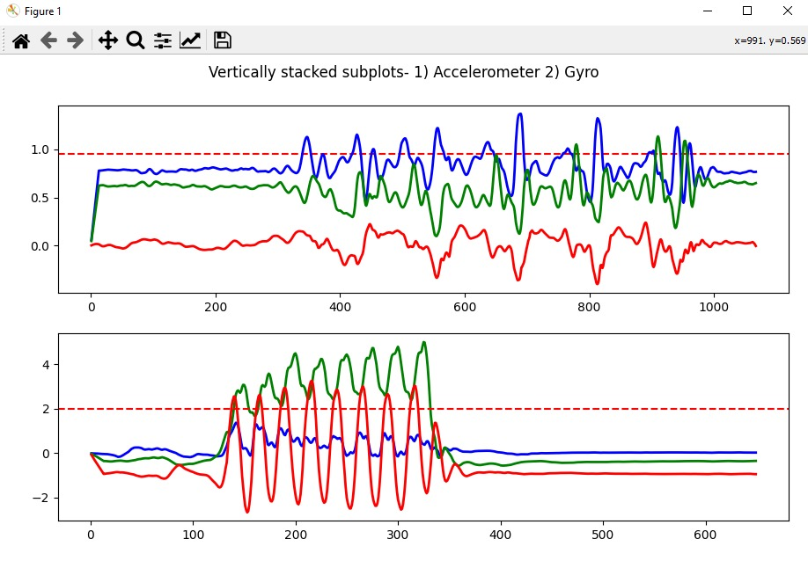

Slide 11
USING GPS
Steps might be counted falsely when travelling in a vehicle.
Using GPS, the speed is calculated and if the user is travelling unusually faster than a walking, jogging or running person, the steps counted will be considered fake.

Slide 12
APP ARCHITECTURE
2
Let’s start with the first set of slides

Slide 13
APP ARCHITECTURE
Pushing of data to database
Get user name
Fetching of calculated steps
Fetch data from sensor
displaying
Storing data in buffer
Regulating data

Slide 14

SO, WHAT’S NEW?

Slide 15

Pedometer design
Tracking user’s speed
Personalized for users

Slide 16
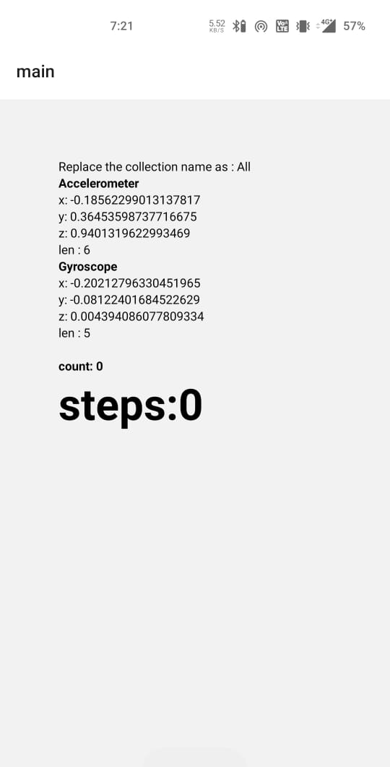
APP VIEW

Slide 17
TECHNOLOGIES USED

Slide 18
TECHNOLOGIES USED
MATPLOTLIB
PANDAS
FIREBASE ADMIN
SCIPY
REACT NATIVE

Slide 19
THANKS!

